Slide 1
World Bank Trends
What does it mean to prosper?

Slide 2
Background
The World Bank
Gini Coefficients
HDI index
The world bank is an international organization that provides financial aid to countries with the goal of supporting economic development and reducing global poverty
The Gini coefficient measures income inequality within a population, ranging from 0 to 1
The Human Development Index measures a country’s averages in the quality of health, education, and standard of living

Slide 3
Data Sourcing
World Bank Indicators
World Bank HDI
Combined
This was Kraggle dataset of 215 different variables collected by the World Bank
(215 x 16,960)
This is another dataset of the HDI of each country calculated by the World Bank
The final data that I used in my analysis was a cleaned, slimmed down, combination of the two

Slide 4
Data Processing
Global politics and current affairs can lead to a lot of blind spots
How can we answer questions using what we know even if it's not a perfect data set?
Working with lots inconsistencies

Slide 5
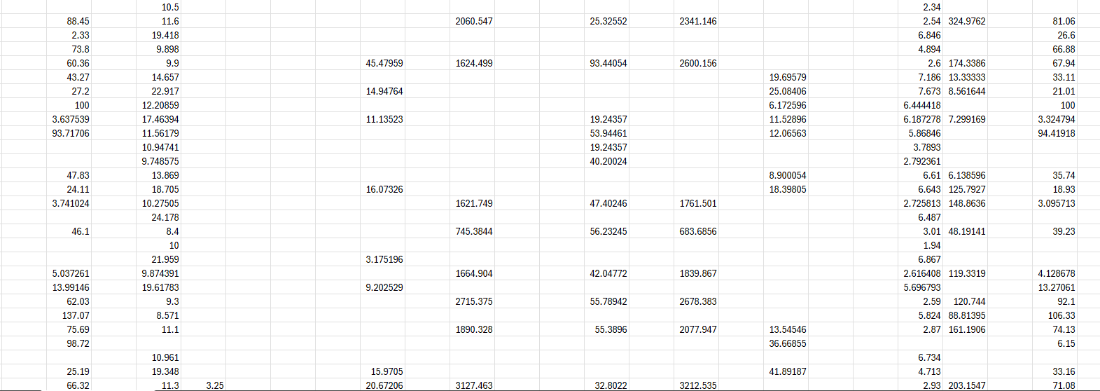
The Data

Slide 6
Implementation

Slide 7
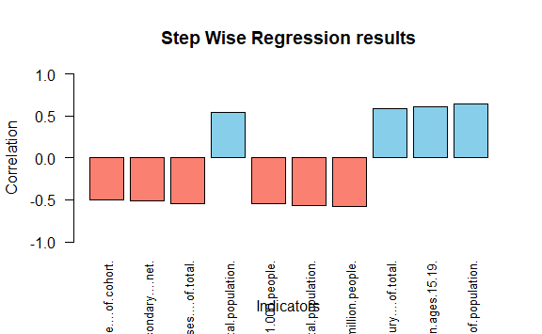
Choosing Variables
Stepwise Regression
Male completion of primary school: -0.5042666
Enrollment into secondary school: -0.5092754
Cause of death by NCD: -0.5424422
Portion of population ≤ 14: 0.5455878
Hospital beds per 1,000 people: -0.5487567
Portion of population ≥ 65: -0.5680435
Researchers in R&D per million people: -0.5822693
Cause of death by injury: 0.592668
Adolescent birth rate (15-19): 0.613928
Portion of population in poverty: 0.6417278

Slide 8
Trends

Slide 9
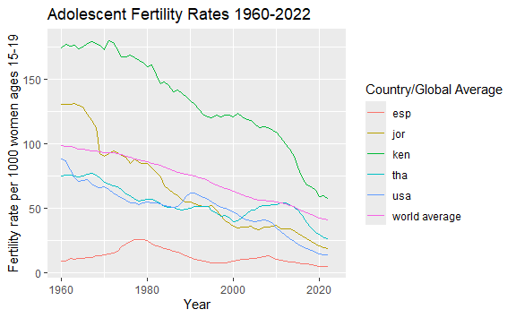
Adolescent Birth Rates
Remember this is an indicator of lower income countries
Could be Due to:
Distribution of contraceptives
Growing Economies
Growing urban migration
Shift away from subsistence agriculture

Slide 10
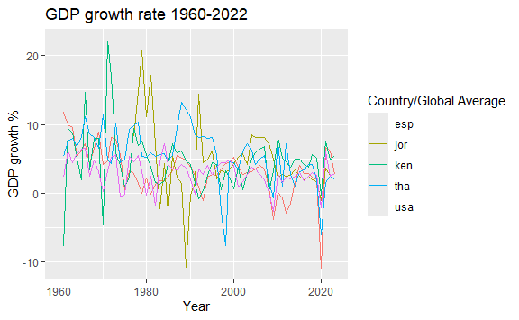
Adolescent Birth Rates
Consistently positive with some shar spikes here and there
The global average rarely dips below 0 in the past 80 years

Slide 11
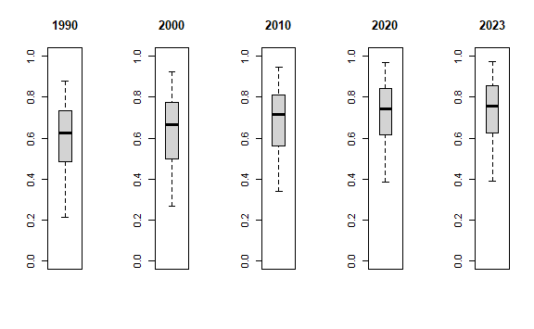
Trends
The global average of HDI ratings has been increasing over time but has definitely slowed down in the past 10 years.

Slide 12
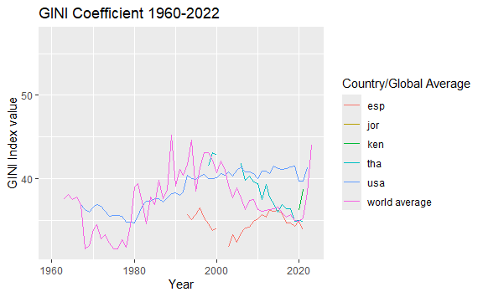
Gini Coefficient Over Time
It has gone up and down with a recent spike post Covid
Seems good on paper, could be worrying

Slide 13
Conclusion

Slide 14
What this tells us
Gini isn’t sufficient
Quality of life vs. Equity
Implicit factors
The Gini index alone isn’t a sufficient indicator of how a country is doing
There seems to be a negative correlation between the quality of health and education vs. income equality
Even within the top 20 indicators, income never made the list. Honorable mentions: Government spending(-), Energy use per capita(-), road injuries(+), crude birth rate (+)

Slide 15
Next steps
Improved and Widespread Data Collection
Global Poverty and Quality of Life

